Slide 1
Student Portfolio
STUDENT NAME :SHARUNITHI.M
REGISTER NO AND NMID :24132251802522049 AND
asanm225anm22524132251802522049
DEPARTMENT :B.Sc COMPUTER SCIENCE (II YEAR)
COLLEGE: COLLEGE/ UNIVERSITY:GOVERNMENT ARTS AND SCIENCE COLLEGE,
VANUR,VILLUPURAM DIST./ANNAMALAI UNIVERSITY.

Slide 2
PROJECT TITLE
STUDENT PORTFOLIO-
SHOWCASING SKILLS & AND ACHEIVEMENTS

Slide 3


AGENDA
Problem Statement
Project Overview
End Users
Tools and Technologies
Portfolio design and Layout
Features and Functionality
Results and Screenshots
Conclusion
Github Link
3/21/2024 Annual Review

Slide 4

PROBLEM STATEMENT
STUDENTS FACE CHALLENGES IN EFFECTIVELY SHOWCASING THEIR SKILLS AND ACHEIVEMENTS USING TRADITIONAL RESUMES.A DIGITAL PORTFOLIO SOLVES THIS BY PROVIDING A CREATIVE AND INTERACTIVE PLATFORM TO HIGHLIGHT PERSONAL PROJECTS,TALENTS,AND ACCOMPLISHMENTS.

Slide 5

PROJECT OVERVIEW
THIS PROJECT IS ABOUT CREATING A STUDENT PORTFOLIO WEBSITE TO SHOWCASE PERSONAL DETAILS,ACADEMIC ACHEIVEMENTS,SKILLS, AND PROJECT IN A DIGITAL FORMAT.IT PROVIDES AN INTERACTIVE AND PROFESSIONAL PLATFORM FOR STUDENTS TO PRESENT THEIR TALENTS,MAKING IT USEFUL FOR JOBS,INTERNSHIPS,AND ACADEMIC OPPORTUNITIES.

Slide 6

WHO ARE THE END USERS?
1.STUDENTS-WHO CREATE AND MAINTAIN THEIR PORTFOLIO
2.TEACHERS/MENTORS-WHO REVIEW STUDENT ACHEIVEMENTS AND PROGRESS
3.RECRUITERS/EMPLOYERS-WHO EVALUATE STUDENTS FOR JOBS OR INTERNSHIPS
4.PEERS/GENERAL PUBLIC-WHO CAN VIEW THE STUDENTS SKILLS AND PROJECTS ONLINE

Slide 7

TOOLS AND TECHNIQUES
1.HTML5-FOR STRUCTURING WEB PAGES
2.CSS3-FOR STYLING AND LAYOUT DESIGN
3.JAVASCRIPT-FOR INTERACTIVITY AND DYNAMIC CONTENT
4.VS CODE-AS THE CODE EDITOR
5.GIT&GITHUB-FOR VERSION CONTROL AND HOSTING

Slide 8
PORTFOLIO DESIGN AND LAYOUT
HOMEPAGE-INTRODUCTION WITH NAME AND TAGLINE
ABOUT ME-PERSONAL DEATAILS AND ACADEMIC BACKGROUND
SKILLS-TECHNICAL AND SOFT SKILLS IN A CLEAR FORMAT
PROJECTS-SHOWCASING WORKS WITH DESCRIPTION AND LINKS
CONTACT-EMAIL,PHONE AND SOCIAL MEDIA LINKS
8

Slide 9
FEATURES AND FUNCTIONALITY
1.RESPONSIVE DESIGN
2.INTERACTIVE NAVIGATION
3.SKILLS SHOWCASE
4.PROJECT GALLERY
5.CONTACT FORM/LINKS
6.SOCIAL MEDIA INTEGRATION

Slide 10
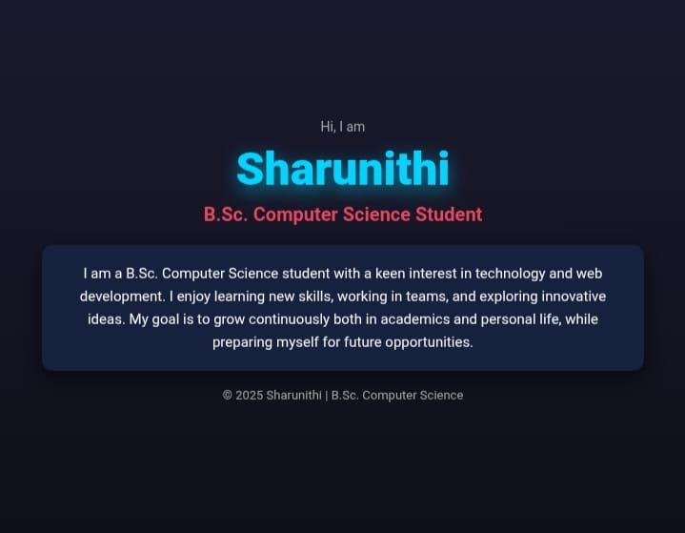

RESULTS AND SCREENSHOTS
3/21/2024 Annual Review
10

Slide 11
GITHUB

Slide 12
CONCLUSION
THIS PROJECT SUCCESFULLY CREATED A STUDENT PORTFOLIO WEBSITE THAT HELPS STUDENTS PRESENT THEIR SKILLS,ACHEIVEMENTS,AND PROJECTS IN A PROFESSIONAL WAY.IT PROVIDES AN EASY AND INTERACTIVE PLATFORM FOR CAREER OPPORTUNITIES,INTERNSHIPS,AND ACADEMIC GROWTH.
12

